Slide 1
Project update 2
Quadcopter project, Jonas and Sigge

Slide 2
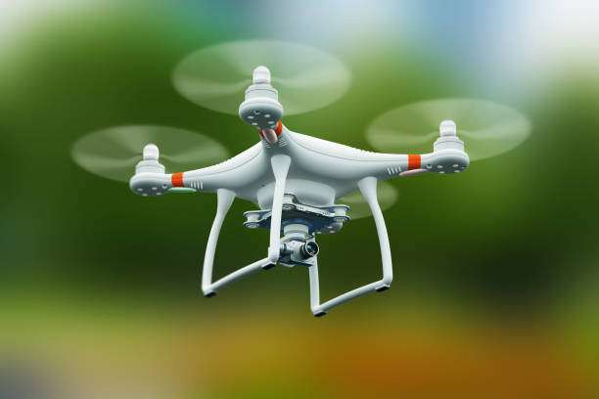
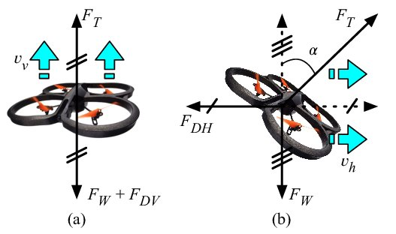
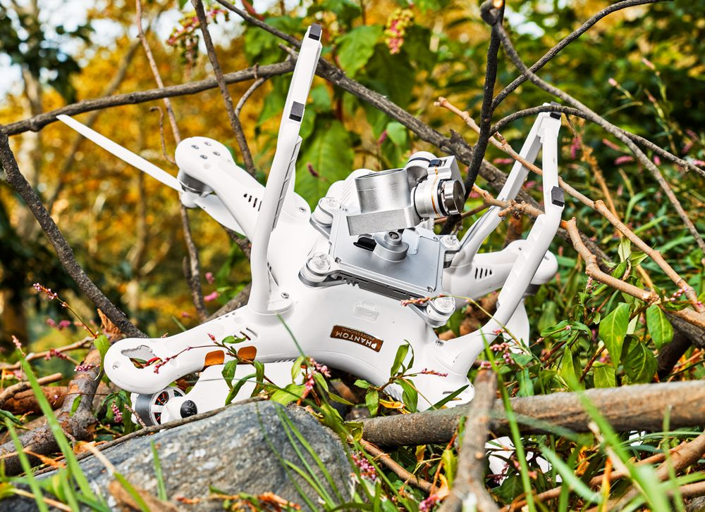
Summary
Learning how to stabilize a quadcopter

Slide 3
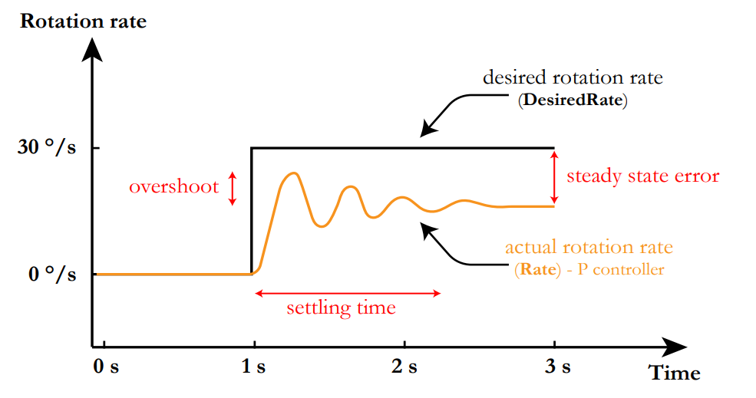
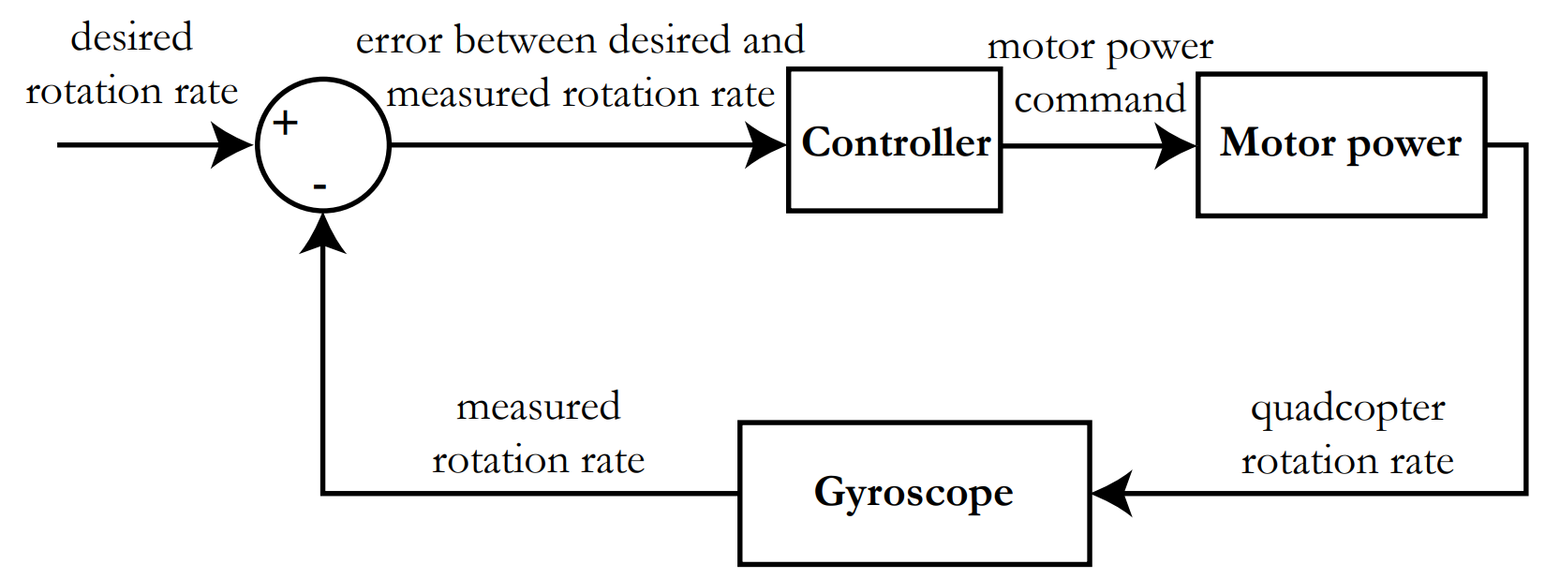
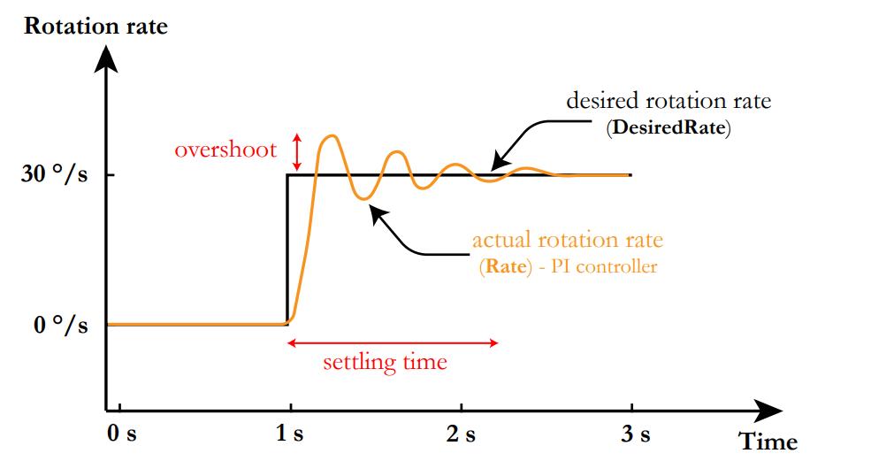
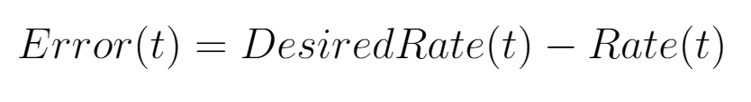
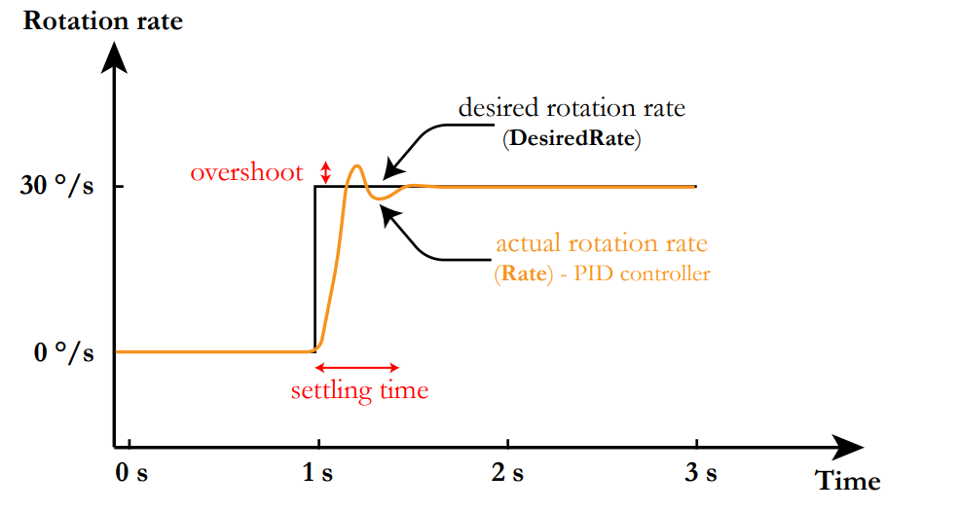
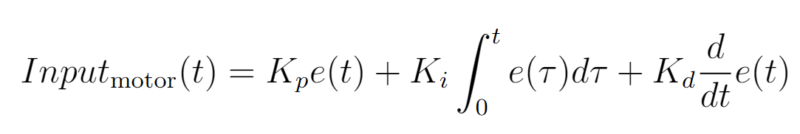
Stabilizing the quadcopter

Slide 4
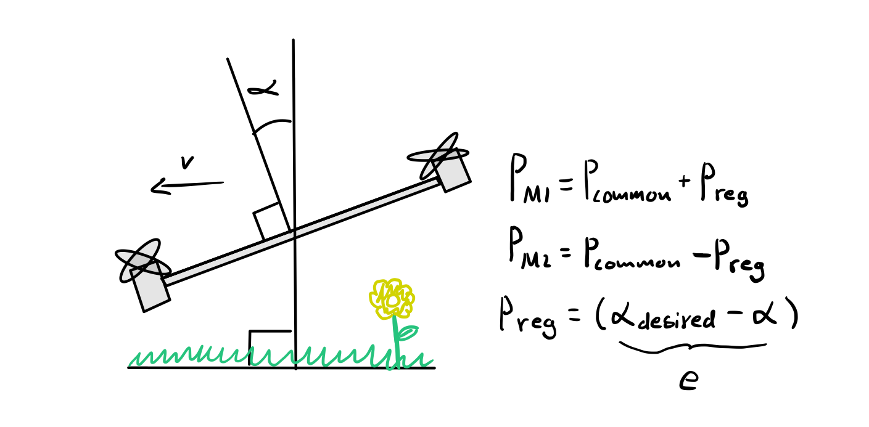
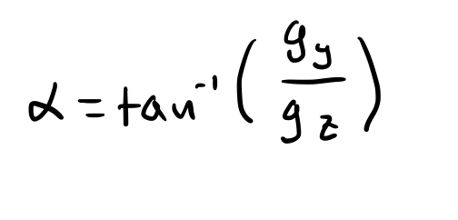
First draft of our drone controller
Angle is calculated by measuring gravity with accelerometer
This sucks!
Solved by measuring and controlling angular velocity instead
gz
g
α
gx

Slide 5
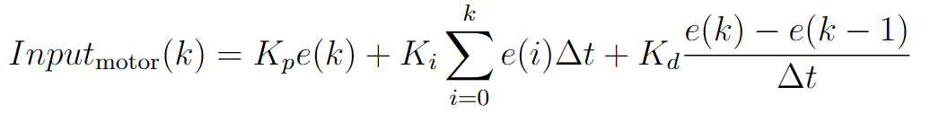
Implementation
void loop()
{
e = ref - y;
P_term = Kp*e;
I_term += I + Ki*e;
D_term = Kd*(e-e_prev);
Input = 1325 + P_term + I_term + D_term
e_prev = e;
}
* Assuming that the loop runs once per Ts…

Slide 6
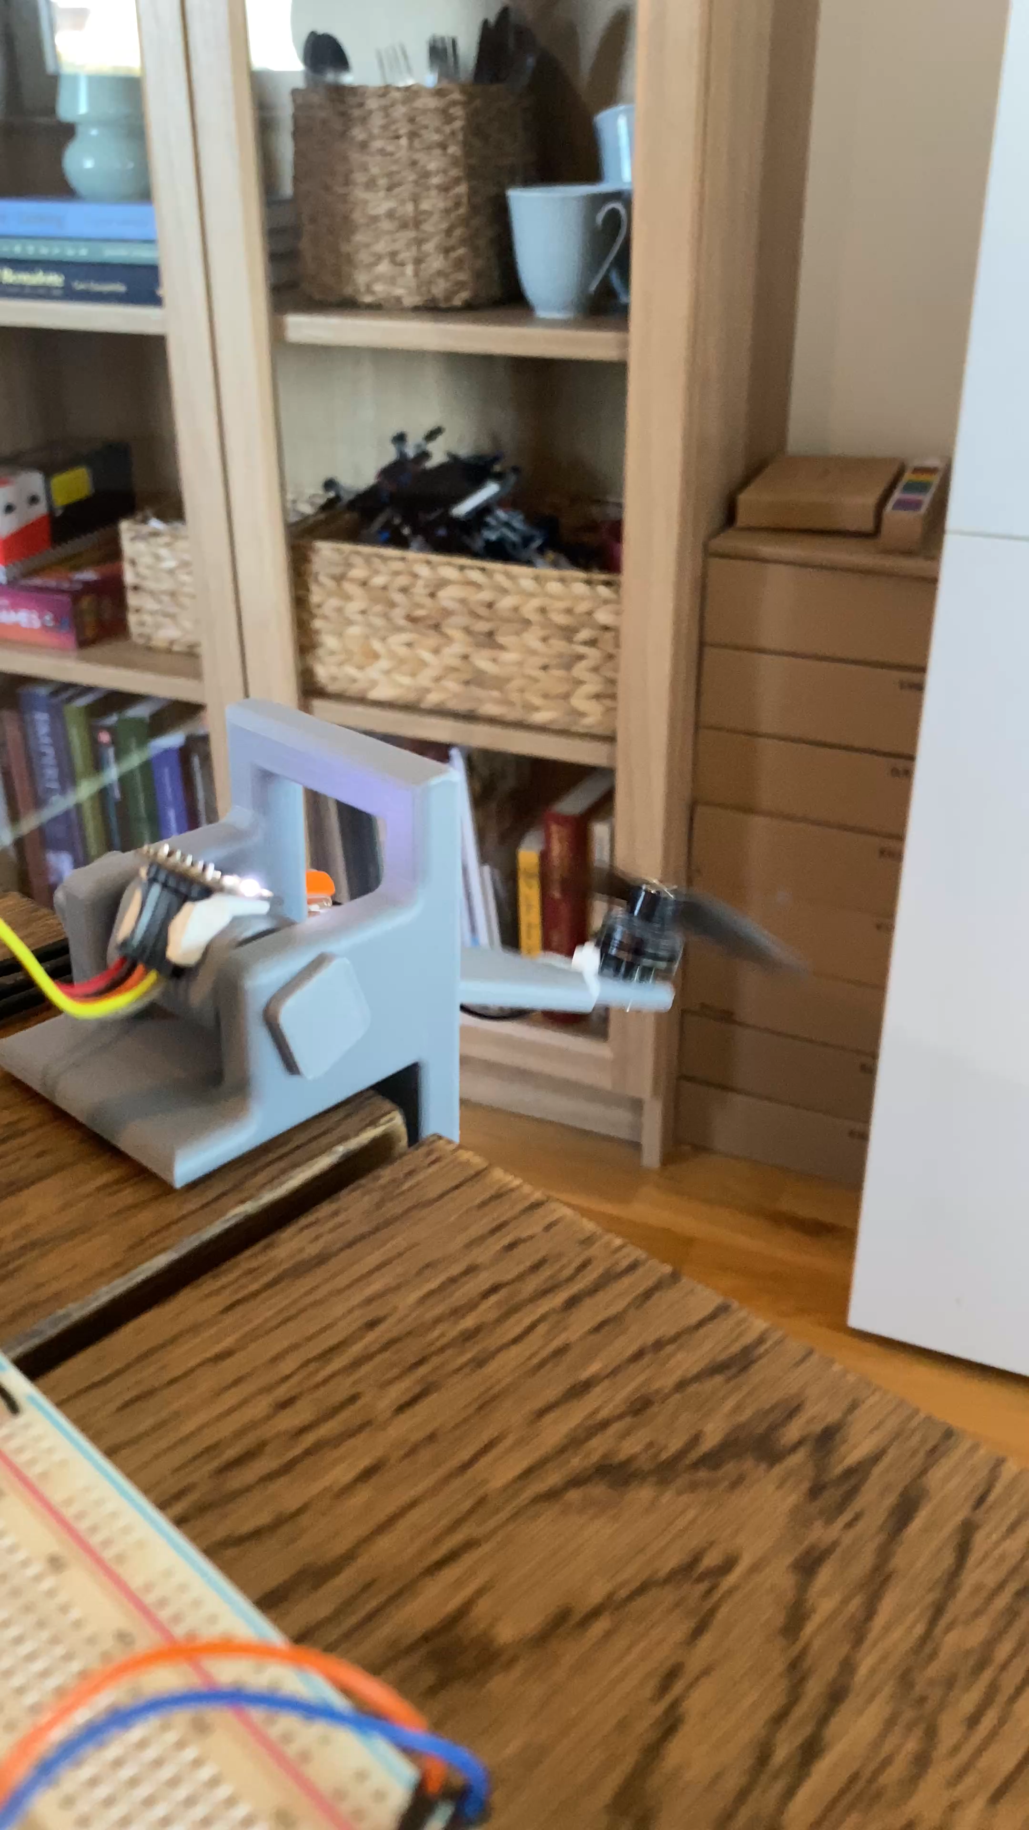
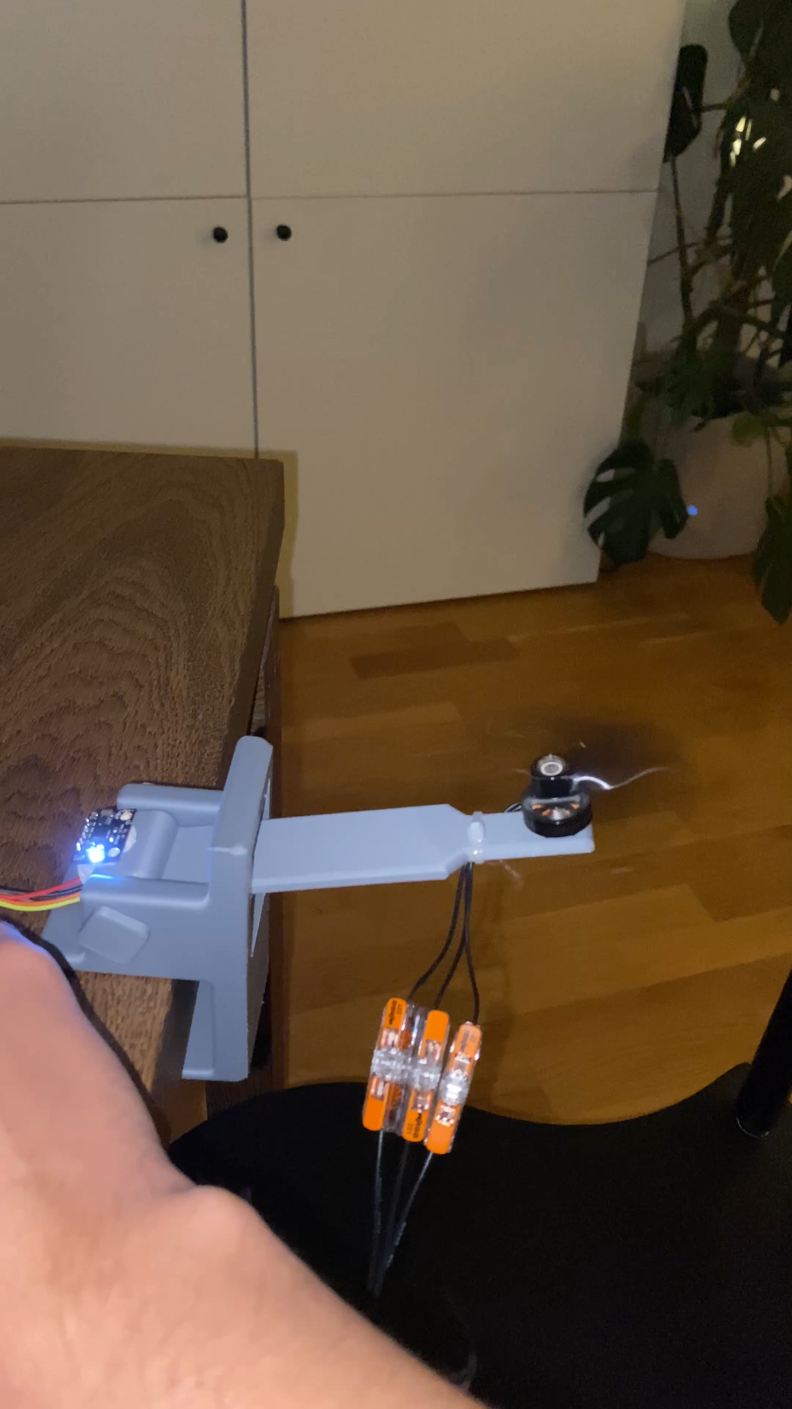

Slide 7
